Slide 1

INFM 600
Career Projections
Team 3: Gaurav Hasija, Kayla Covington, Mary Dalrymple, Corie Brown, Tsion Zewolde

Slide 2

Introduction
We understand the difficulty that comes with searching for a job and ensuring you have the appropriate qualifications and experience for a possible career. Students will often ask, “How am I going to use this material in the real world? When will I see this material again in the real world?” Our team has decided to address these common questions and create a tool for students to see job opportunities based on the courses they take.
Notes:
When am i going to apply the skills that i’ve learned in class to the real world?
What can i do in this class to apply the skills to in the jobs that i want?
How can i start planning out my future class schedules to match what i want to do when i graduate?
How i can shape my curriculum and projects to my career goals?

Slide 3


Project Overview
This analysis and mapping service would be provided in the form of easy-to-understand Tableau reports, designed for easy use by academic advisers and students in planning courses. A user could examine the data from both sides to answer the questions, “How does this course relate to the trending job market?” and “How could I prepare for this trending job with the courses being offered?” Online accessibility would be the best way to put this service into use because it would be accessible to a majority of students on campus. Any student with Internet access has access to this tool.
Career Projections

Slide 4

Project Overview
We expect the outcome of this information service to help students better understand the job outlook and trending jobs related to their education curriculum and educational interests and therefore make better-informed choices. In addition to the benefit of steering students toward courses related to trending jobs, this service can also pinpoint occupations with high compensations and identify roles that are steadily declining.
Career Projections

Slide 5


Vision and Objective
Academic Advising
Career Planning
Career Projections is a utility that complements the two major components of education — academic advising and career planning. Our objective is to bridge the gap between these two components for improved academic advising, career-focused course selection and optimal degree planning. Also, our service can be used independent of university systems for determining the trending jobs, related long-term projections and factors affecting job outlooks.

Slide 6



Service Environment
For Students and Advisers
Course Schedules
(Used by Students)
UMD Degree Planning System
(Used by Academic Advisers)
Our service perfectly blends with the existing application ecosystem of the university, such as Testudo (schedule of classes) and uAchieve. It can be positioned between these two university systems in terms of related use case.
We have identified the existing technical environment of the university that will be optimal for this type of Tableau-based service, which is UMD’s reports platform: https://reports.umd.edu

Slide 7


Introduction to the Data Sources
For this new information service we used the course lists provided by an academic adviser at University of Maryland College Park. In correlation, we also used BLS (Bureau of Labor Statistics) data files to find the corresponding job occupations, salary, and experience needed for those given occupations.

Slide 8
BLS Data
BLS Annual Occupational and Wage Estimates
The service extracts median annual wage, percentile distribution of annual wages from BLS occupation and wage data for Computer & Mathematical and Education & Library Occupations. (https://www.bls.gov/oes/home.htm)
BLS Occupational Projections
The service extracts expected new job openings 2019-2029, typical education required, work experience in related field required, self-employment rates, and factors affecting employment from BLS occupational projections. (https://www.bls.gov/emp/)

Slide 9
iSchool Data
UMD iSchool Courses:
The service extracts course codes, course names and course descriptions as provided by the iSchool and Testudo.
It matches course codes to course descriptions and relevant occupations.
One course may map to multiple computer/mathematical and/or library related job titles obtained from BLS data.

Slide 10


Data Preparation
STEP 1 STEP 2 STEP 3
Vision & Data Collection
Data Pre-Processing
Exploration & Insights
Read various literature and papers to envision the service and identify the data we want to collect for our service.
Explored to identify data sources and narrow down to major ones.
From the data collected, finalized the unifying vision of the service and identified the relevant environments.
Major: Manually mapped iSchool courses with collected BLS data job titles.
Cleaned the wage data and projections data to remove unwanted features. Null values were filled or removed as requirements.
Created hierarchy in the data to enable aggregation.
Exploratory analysis is performed and most prominent observations are identified.
Aggregation is performed to provide user with comprehensive view of the data over the long-term.
Visualizations are developed to support the intended users decision.

Slide 11


Use Cases
Use Case 1: Student looking for appropriate career inclined course.
Use Case 2: Academic adviser curating a customized degree plan based on student’s career interest.
Step 1: Student logs in to Testudo (schedule of classes) to explore courses offered in the semester.
Step 2: After identifying the offered courses, student now explores job titles and related projections on our service.
Step 3: Student registers for the identified course supporting his best career interest.
Step 1: Adviser logs in to identify existing courses for the student.
Step 2: Adviser now identifies the courses that match with all the job titles related to student’s existing courses from step 1.
Step 3: Adviser curates the degree plan based on courses identified in step 2 and suggests courses to student for registration.

Slide 12
Service Demo
https://public.tableau.com/profile/gaurav.hasija5250#!/vizhome/CareerProjections/CourseDescriptions?publish=yes

Slide 13
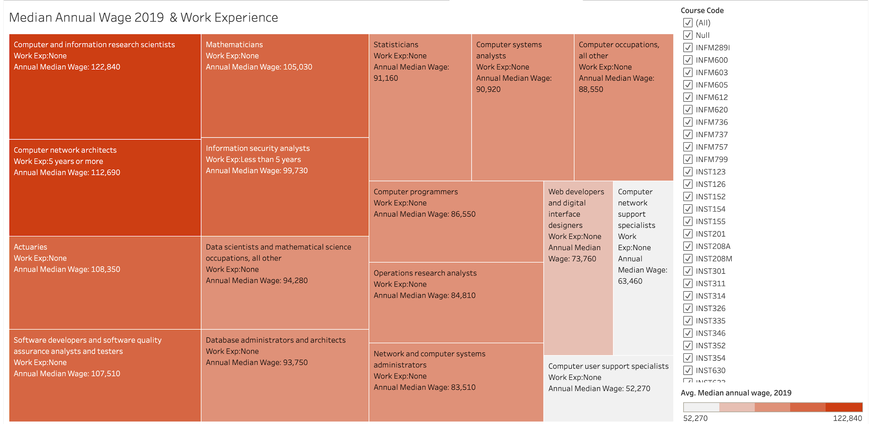
Tableau Report: Median Annual Wage 2019 & Work Experience
The highest paid positions in the Median Annual Wage report for 2019 belonged to Computer & Information Research Scientists and Computer Network Scientists at $122,840 and $112,690, respectively.
Notes:
Speaker Notes: This tableau report is comparing the annual wage to the work experience required for these particular occupations. These occupations are tied to the courses in the Ischool; the occupations for those particular courses. The key is highlighting that darker orange is a higher annual wage, and as the colors get lighter the median annual wage decreases. This chart also compares the work experience required for these occupations. For some occupations such as the “Computer and information research scientists” there is no work experience required but that occupation makes the highest annual median wage.

Slide 14
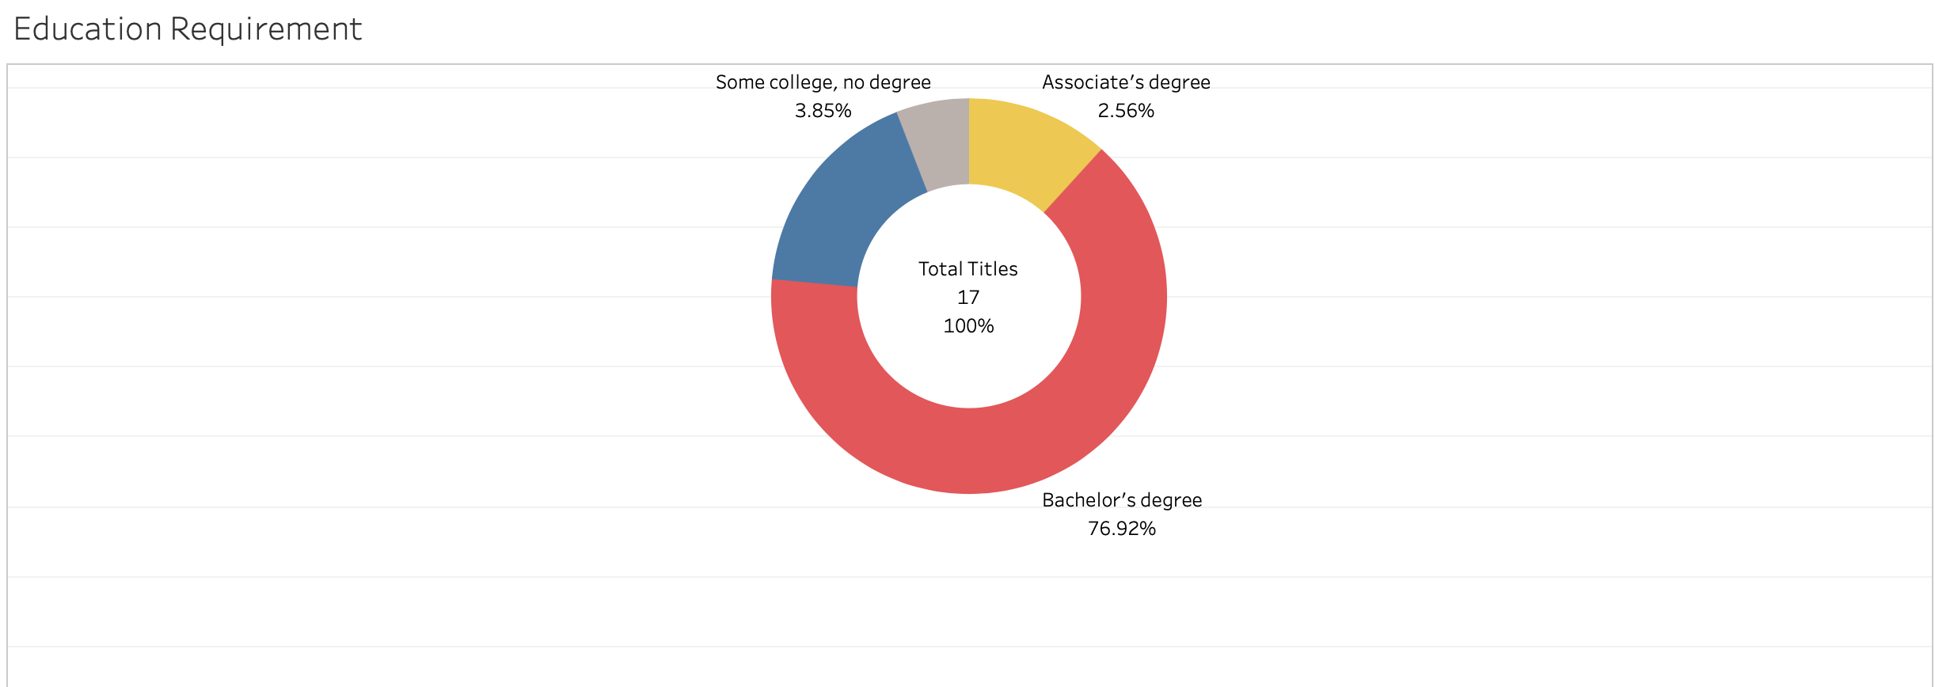
Educational Requirement
Based on this Tableau report, the reader sees that 76.92 percent of these occupation titles require a Bachelor's degree. There are 16.67 percent that require a Master’s degree for the specific job title. While 3.85 percent require some-to-no college degree; 2.56 percent require an Associate’s degree.

Slide 15
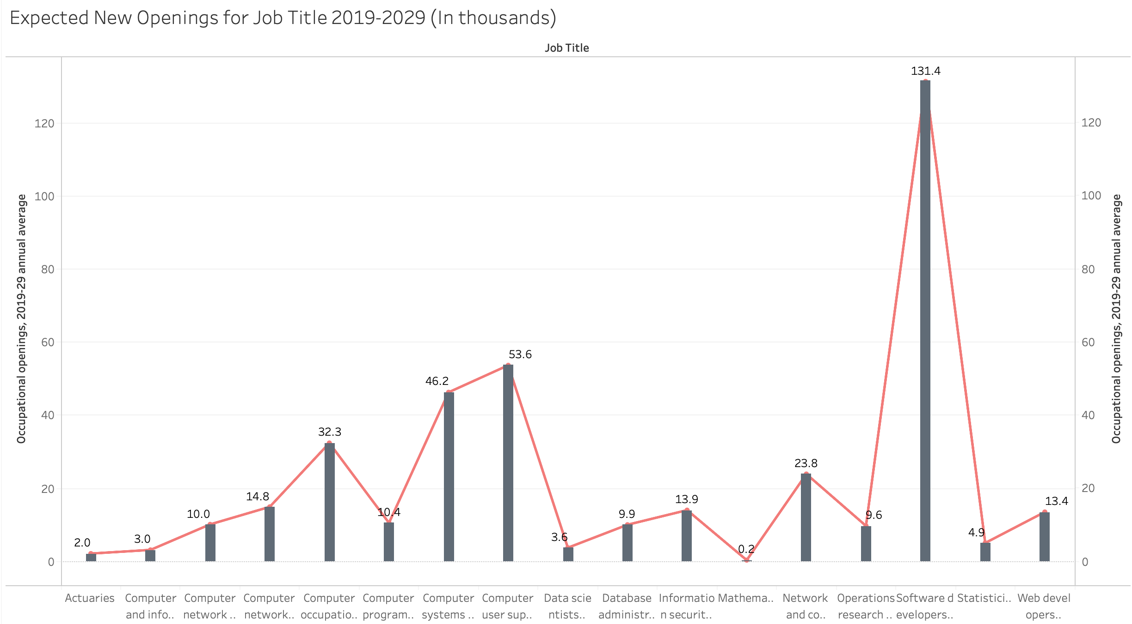
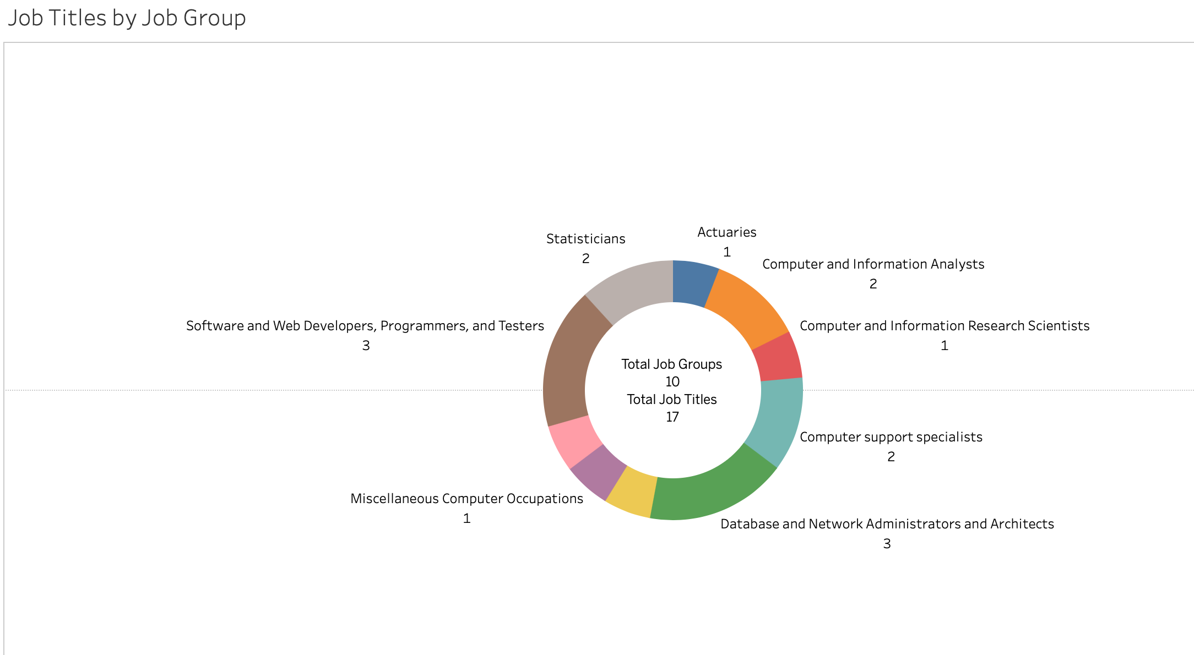
Expected New Job Openings
There were 17 job titles, grouped into 10 groups. The chart to left is projecting the expected new openings within these job titles from 2019-2029. The numbers above the chart are a description of the number of jobs that will be open within that given title for the expected years (2019-2029).

Slide 16
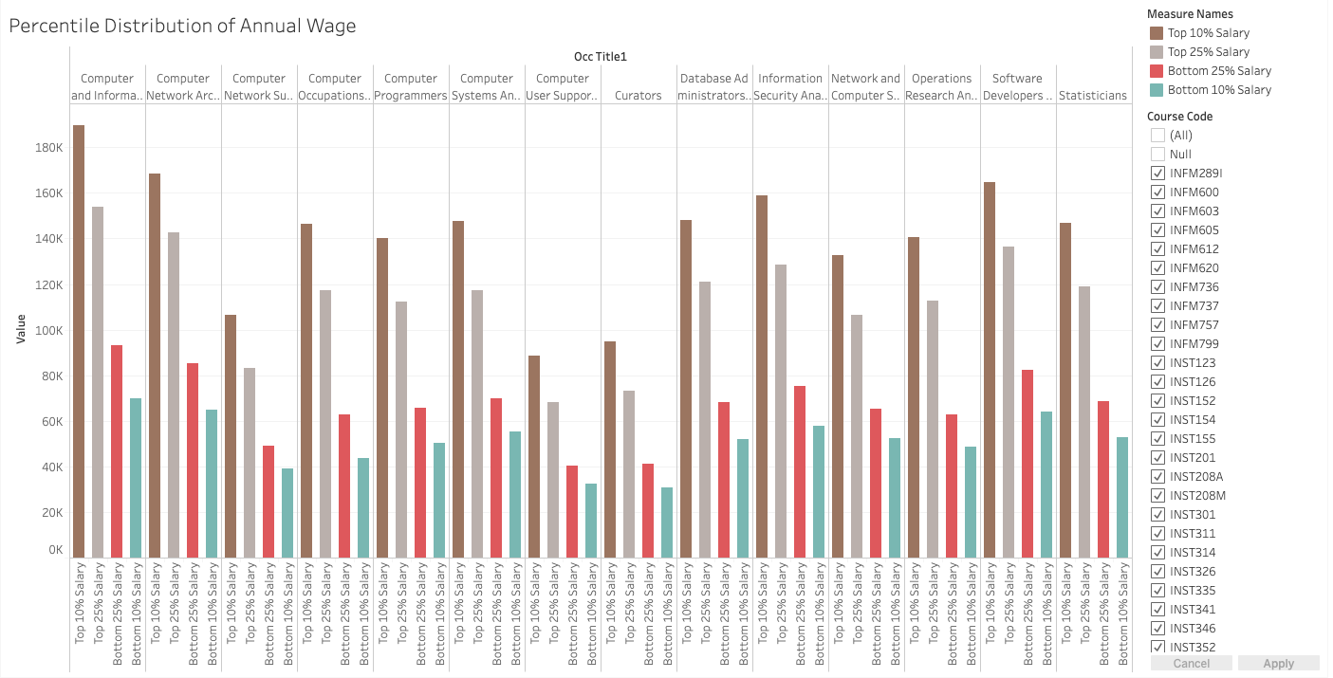
Percentile Annual Wage Distribution
This graph shows that Actuaries, Computer and Information Systems Professionals, and Software Developers were the top titles with highest salaries among top 10% earning professionals. This confirms that the STEM field still fares well in the professional realm.

Slide 17
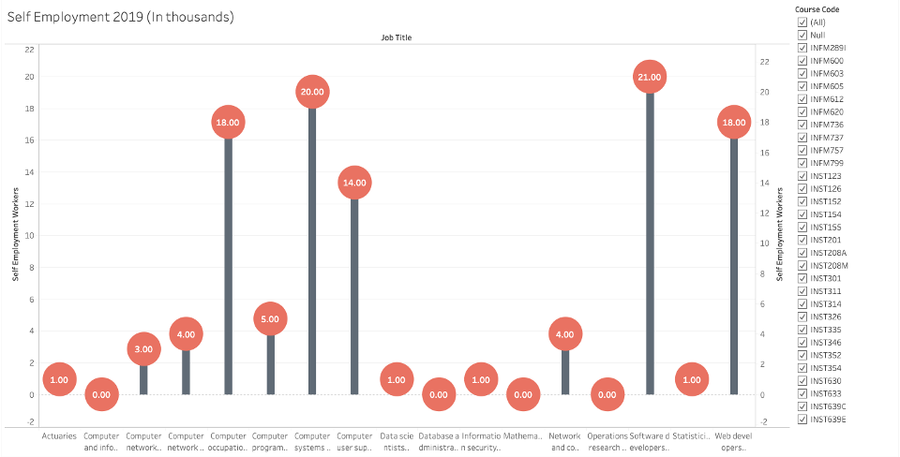
Self-Employment
Self-Employment has seen a major upward shift over the past few years, but 2019 has some of the highest marks yet. These workers did not find jobs under conventional working standards, but the demand for career control is becoming more prominent.

Slide 18
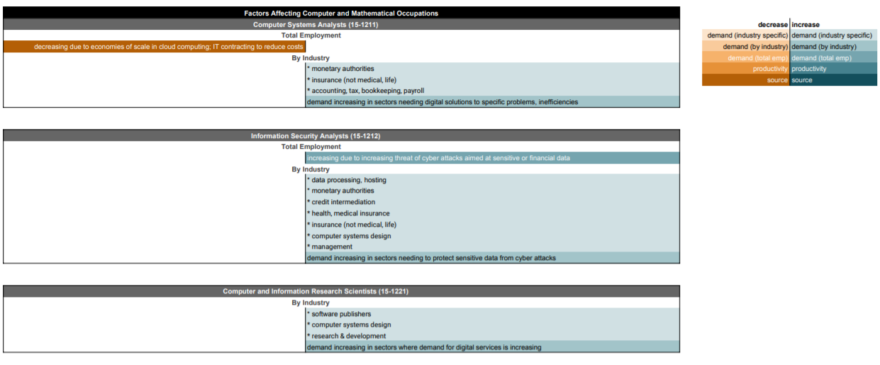
Factors Affecting Occupations
Analysis shows the economic forces putting upward and downward pressure on job creation over the coming decade for information occupations in industries throughout the economy.

Slide 19
Envisioning integration with the iSchool
To implement of this service in an existing process at the iSchool, the following enhancements would be needed:
Programs like MIM and HCIM have some predefined core courses. Therefore, we envision this service to be helpful in selection of appropriate elective courses. It could also help programs like MIM and HCIM continually evaluate the key career demands that need emphasis in their core courses.
We acknowledge that job requirements change more quickly than any course curriculum, and not all courses are targeted towards specific job title, as some are focused on special areas of research and community well-being.
To manage this temporal difference, this service should be owned by a department that works closely with career services and instructional design. A department of this type would best at quickly identifying and bridging this gap.
To put this into real perspective, we see a department can be a combination of Teaching and Learning Transformation Center at UMD and UMD Career Center.

Slide 20
Thank You

